Slide 1

Onigiri-Project, is a dynamic website teaching Japanese language and culture. Featuring courses, interactive lessons with multimedia content, and user accounts for progress tracking.
Part of 紅葉言語学院
ONIGIRI

Slide 2


OUR COMPANY’S
FOUNDERS
description about company
At The Onigiri-Project, our founders are trailblazers driven by an unwavering passion for Japanese culture and language. Their visionary dedication birthed a cutting-edge web app. This platform, meticulously crafted, embodies their pride in offering a rich, immersive experience, welcoming learners to delve into Japan's cultural marvels while mastering its language intricacies.

Slide 3

Empowering Connections Beyond Borders: Bridging Indonesia and Japan Through Language and Culture.
MOTTO OF
OUR COMPANY
some words which is become our tagline

Slide 4
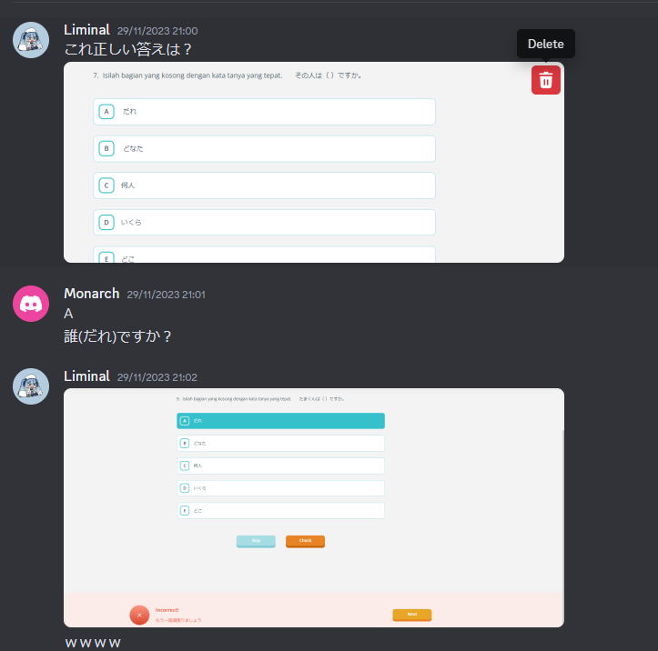

PROBLEM
ANALYSIS
foreword descriptions
Current apps lack depth in Japanese language learning.
Struggles in mastering kanji and intricate grammar structures.
Direct impact on Japan-related industries.
Hinders connections, negotiations, and cultural understanding.
Lack of comprehensive learning materials.
Shortage in resources for kanji, grammar exercises, and essential components.
Barrier to capitalizing on Japanese market opportunities.
Inhibits cross-cultural exchanges crucial for global progress.
start

Slide 5


SOLUTION
FOR YOU
Comprehensive and immersive learning.
Targets proficiency gap for success in Japan-related industries.
Master kanji and grammar structures.
Real-world scenarios and cultural insights for holistic understanding.
Tailored content for global growth demands.
Equips learners for business transactions and cultural nuances.
Vast library of curated content.
Regular updates for current and relevant language skills.

Slide 6


OUR
DEKSTOP
SOFTWARE
practice with our software

Slide 7


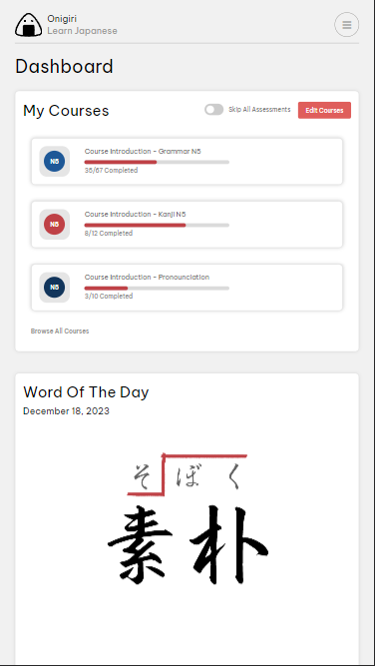
YOUR MOBILE
SUPPORT
expand to your
mobility with
app support

Slide 8







OUR MAIN
FEATURES
the power of association across nations
Login/Signup
"Word of the day"
Search bar and Filters
Simulation Page
Checkout Page
Progress Tracker

Slide 9

DEMO
thank you so much for
your attention

